Slide 1
MSAS Tutorial Sequence -Module Five-
WRITTEN BY

Slide 2

GAME TIME

Slide 3
Goals of Today
Data cleaning
More row operations
Getting information from your data
Column information operations
Data Visualizations
Ideas for the last tutorial?

Slide 4

Cleaning Data
WHY DO WE NEED TO DO IT?

Slide 5
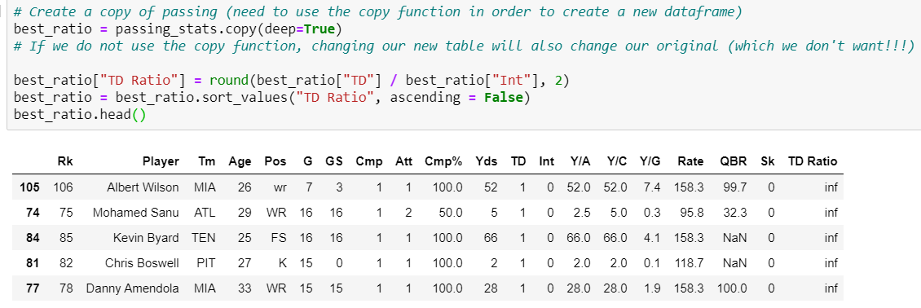
Values Out of Range

Slide 6
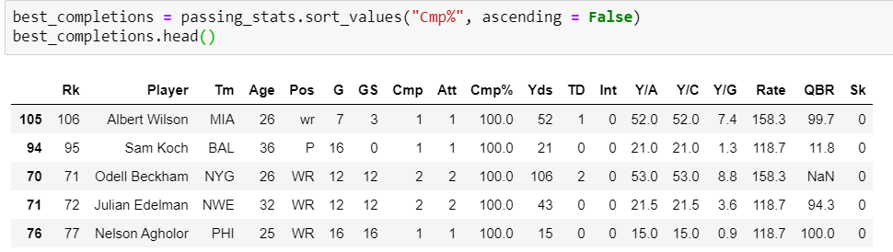
Invalid/Unwanted Data

Slide 7
Filtering
Most of these cleaning operations can be taken care of simply by using inequalities
We learned this last module
Check if the position is a quarterback
Set a threshold for the number of passes thrown
Set a threshold for the number of games thrown/started
We can exclude these rows from our dataset simply because we do not need them
But what about the rows where values are undefined?

Slide 8
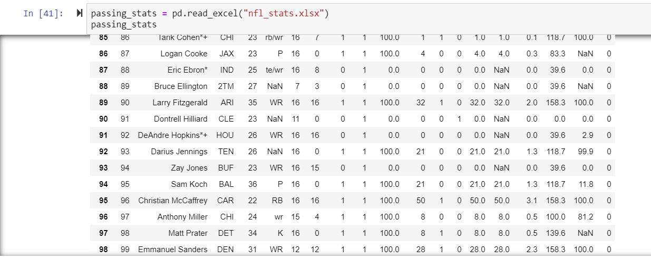
Missing values

Slide 9
“NaN” Values
An “NaN” value is a value that is undefined
Stands for “Not a Number”
Usually placeholders for cells that were left empty in the original DataFrame
Can also be used to represent division by zero in some cases
Why do we care about NaN values?
Disruptive to our DataFrame
Messes up operations on a series we want to do

Slide 10
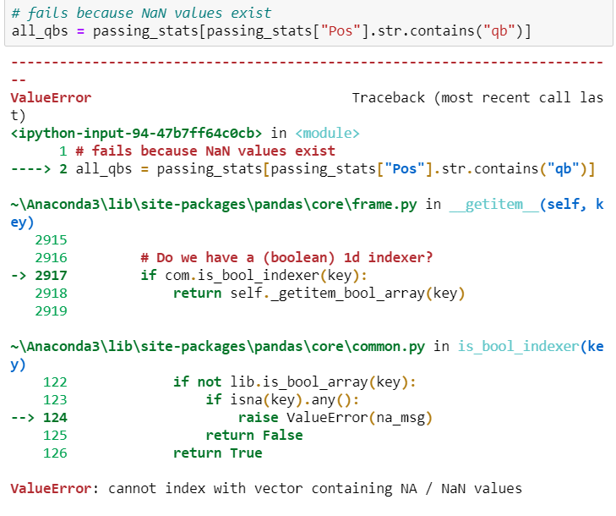
Why are NaN values so bad???

Slide 11
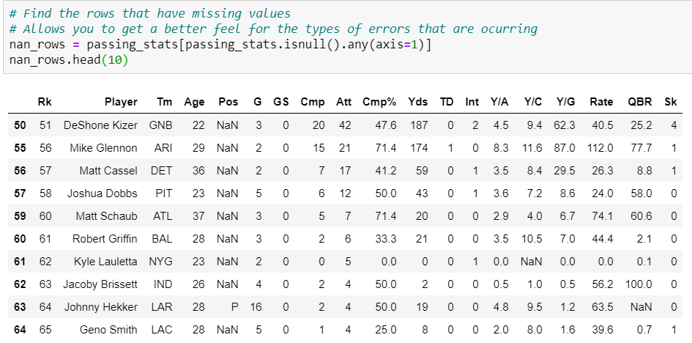
Locate rows with NaN values

Slide 12
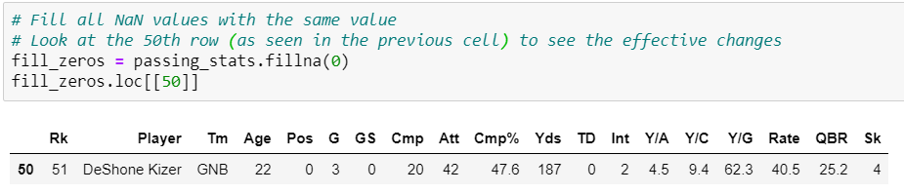
Fill all NaN values
When would filling all values with the same value be useful
If the entire table is comprised of strings, we can fill an NaN cell with an empty string
If the entire table is filled with integers, we can fill with a -1 and only check values that are positive
Other than this, there aren’t many use cases
It is better to be more specific in the ways you want to deal with NaN values
How can we do this?

Slide 13
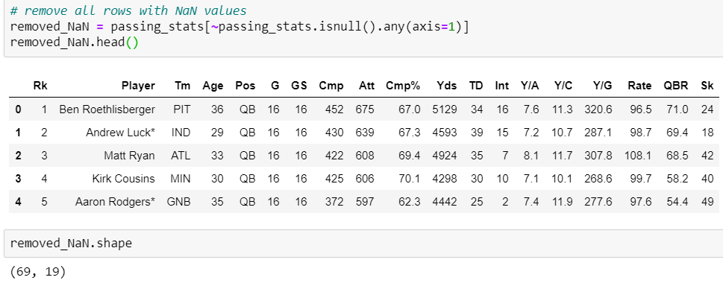
Option #1 – Delete all rows with NaN values

Slide 14
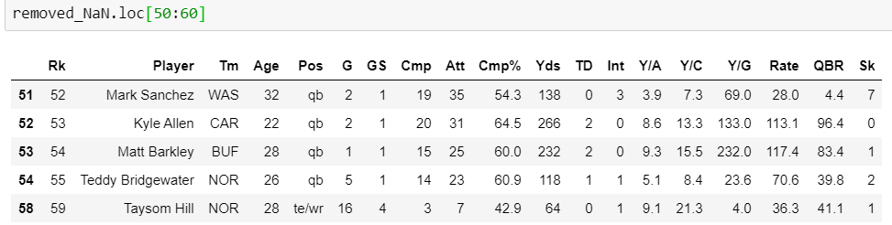
Make sure to restart the index!

Slide 15
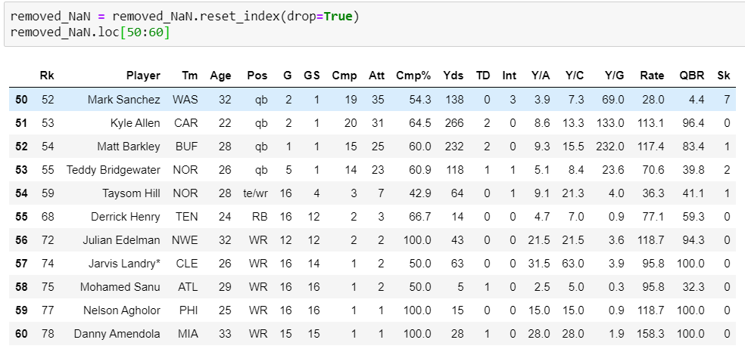
Make sure to restart the index!
Notes:
This is why it is a good idea to reset the index to the player instead of simply using the built-in index (an increasing numerical sequence)

Slide 16
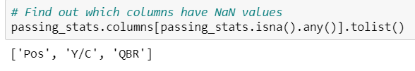
Option #2, Fill each column differently
The first step in this is to determine which columns have NaN values. This is done pretty easily using the following function

Slide 17
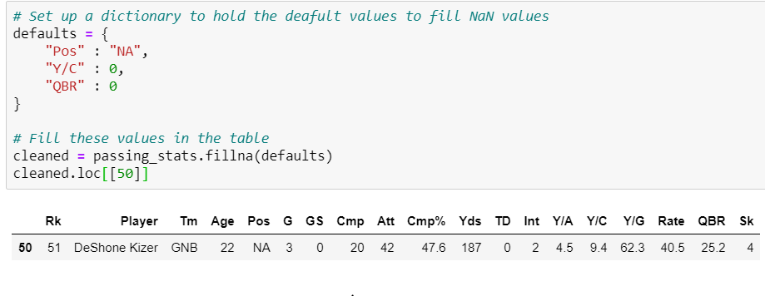
Option #2, Fill each column differently

Slide 18
Final tips for data cleaning
Always be sure to clean your data before doing any analysis
Be mindful of the values you are removing from the table
Make sure you are aware of the consequences of removing or changing values
Excluding values that you should not be excluding can have adverse effects on your final analysis

Slide 19
Getting information from the table
The next section of this module will focus on trends and visualizations
Not designed to be exhaustive, but rather point you in the right direction
A lot of analysis is designed for you to determine what is important and what isn’t
Think about your goals before you start cleaning and visualizing!

Slide 20
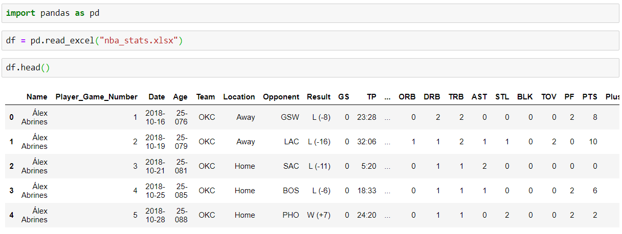
Let’s transition to a new dataset
Every game log of the 2018 season for every player
Open up a new jupyter notebook and read in the new file

Slide 21
Let’s understand the dataset
What do the columns mean?
What are the types of each column?
What is the dataset telling me?
What possible trends could I visualize?

Slide 22
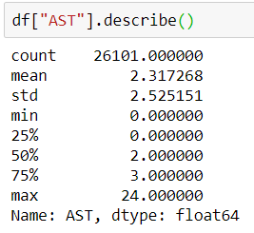

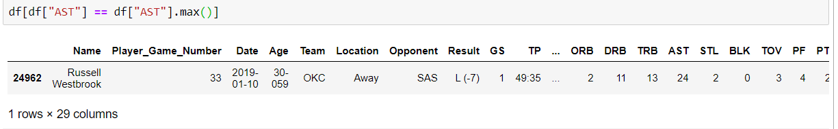
Get information about a column

Slide 23
Plotting
At the top of your jupyter notebook, we will need to import a new library that allows you to plot data
import matplotlib.pyplot as plt
This is not included in the pandas library
Why are data visualizations important?
Good tutorial: http://queirozf.com/entries/pandas-dataframe-plot-examples-with-matplotlib-pyplot

Slide 24
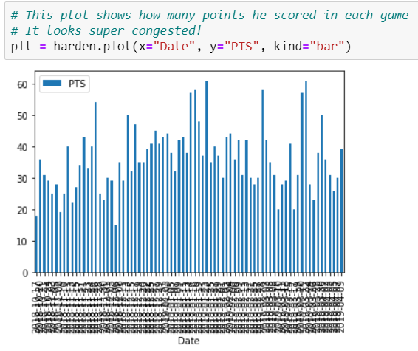
Bar Graphs
Provide an x axis, y axis, and the type of graph you want to see
In this case, the kind is “bar”
What are bar graphs good for?
This example might not be the best idea for a bar graph
How can we make it better?

Slide 25
Bar Graph Part 2, Creating a smaller range
Looking at every date in the season was too much. How about we narrow down our range to be smaller?
Let’s look at the first two weeks of December (arbitrary)
Is there a way we can easily take our DataFrame to slice out this region?
Because the dates are stored as strings, it makes it difficult to compare using inequalities
How do we know if a date is in that range?
We know the dates that we want are in the format: YYYY-MM-DD
We also know we want the dates of 2018-12-01 to 2018-12-14
How can we do this? For loop!

Slide 26
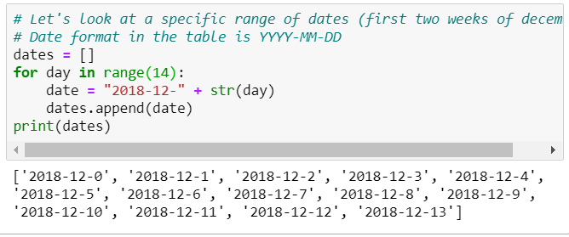
What is missing here?

Slide 27
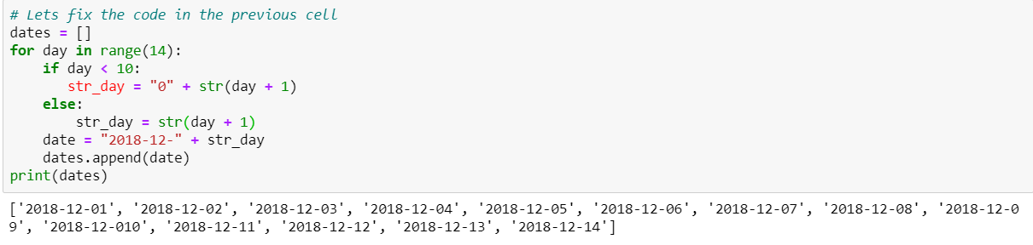
Fixed Code

Slide 28
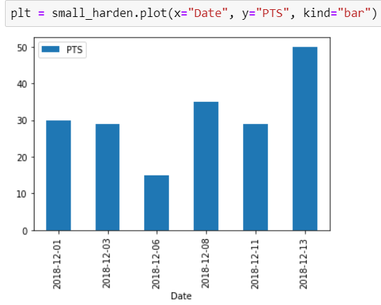
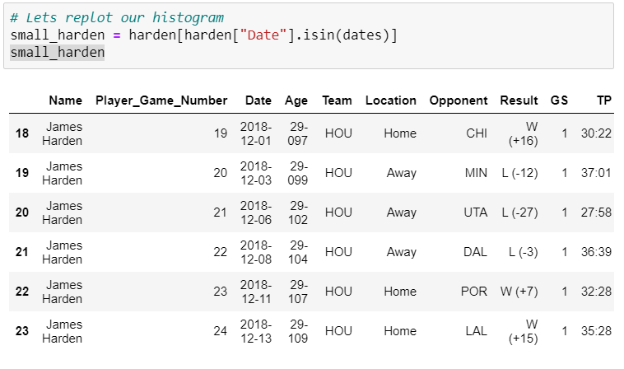
Fixed Bar Graph

Slide 29
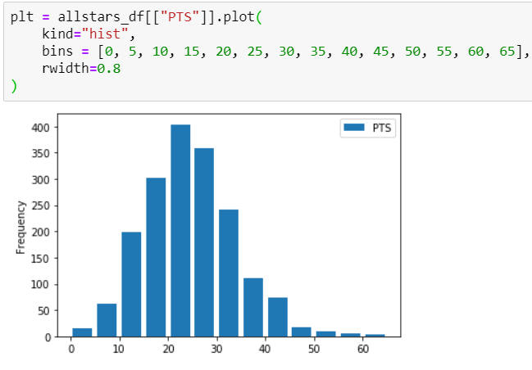
Histograms
Histograms look similar to bar graphs but show groupings of data instead of individual values
When creating a histogram, determine the column you want to analyze and the “bins” you want to use
What are histograms good for?
Determining which values are the most common
Examining distributions

Slide 30
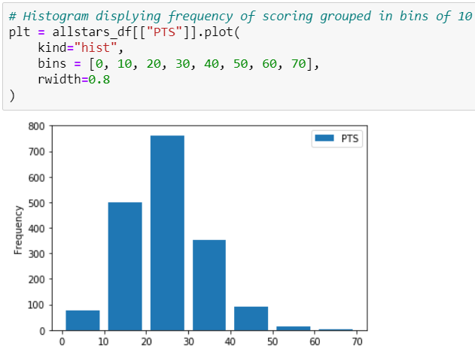
Same Histogram, different bin size!

Slide 31
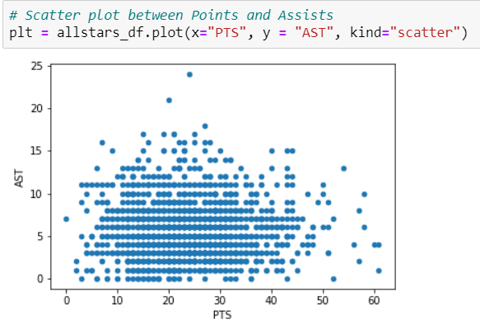
Scatter Plots
Scatter plots attempt to display the relationship between two variables
Why is this useful?
Provide two variables you want to see and plot!

Slide 32
Further applications for you to explore
Improving your visualizations
Adding titles, axis labels
Using different colors
Exploring different types of visualizations
Linear regression
Too long for this tutorial
Graphing multiple trends on the same plot
Use different colors to display multiple trends

Slide 33
Any Questions?

Slide 34
What do you want to see in the last module?
Options
Webscraping live demo
Linear regression tutorial
More visualization help
General live coding demo
Any other options?

